Slide 1
How do common cereal attributes affect consumers’ ratings?
By Team 3:
Efe Aganbi,
Hedieh Basiri,
Anita Koneru,
Sofia Mobley
Hari Teja Narayanabhatla

Slide 2
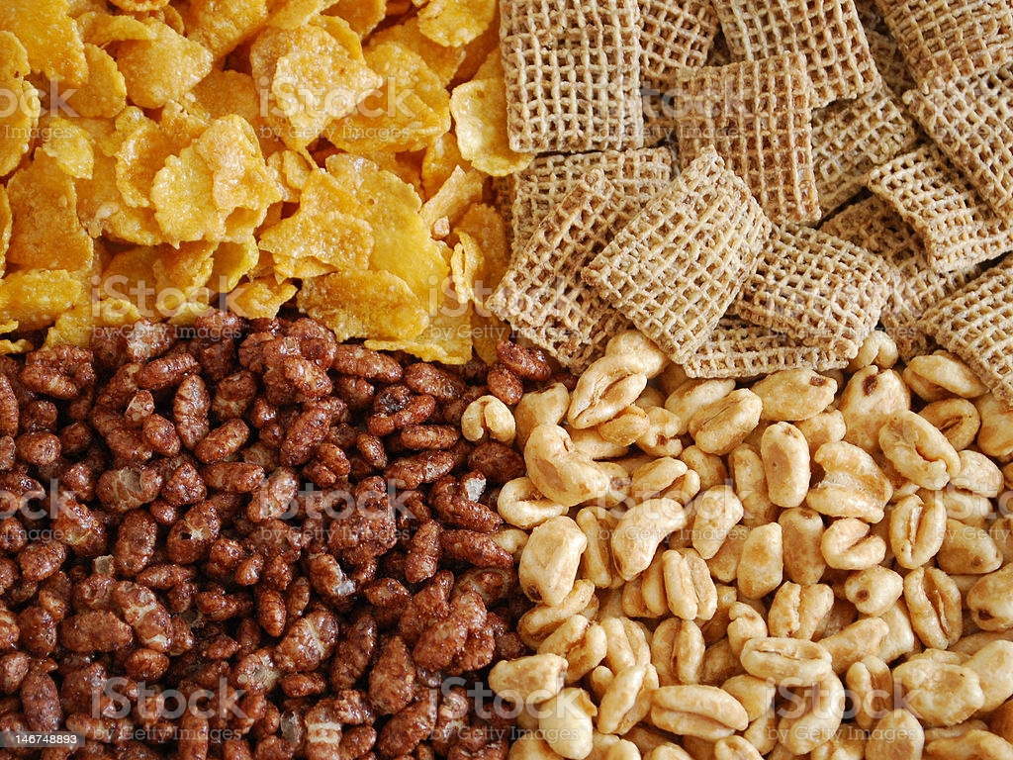
Overview
CSV file that contains 16 features and 77 cereal names with their product ratings
Objective: to build a model to predict product ratings for better business insights

Slide 3
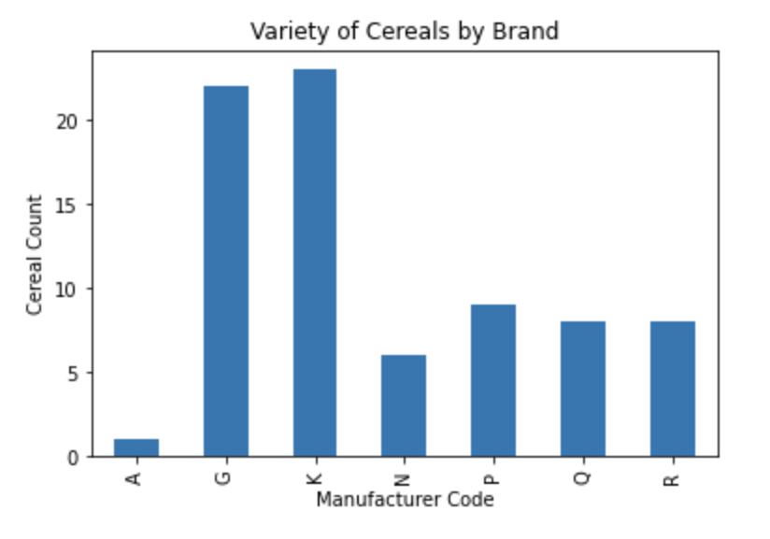
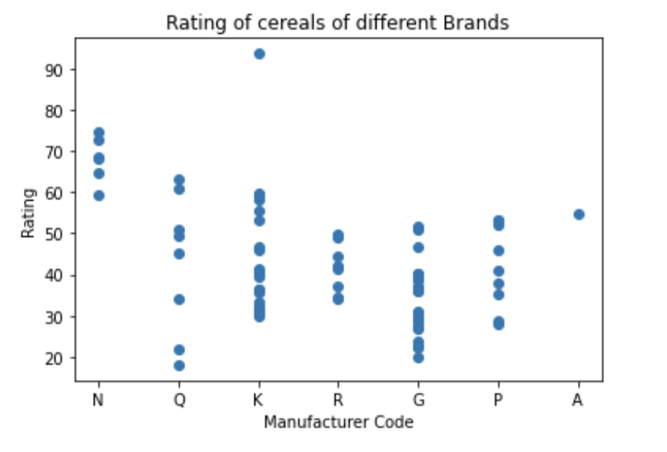
EDA - EXPLORATORY DATA ANALYSIS
Manufacturer Codes
American Home Food Products 1
General Mills 22
Kelloggs 23
Nabisco 6
Post 9
Quaker Oats 8
Ralston Purina 8

Slide 4
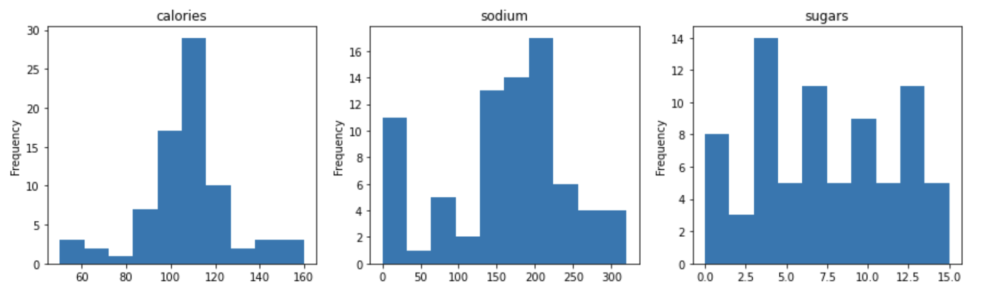
EDA - EXPLORATORY DATA ANALYSIS
Histograms of calories, sodium, and sugars in different cereals
Most of the cereals have:
Calories 80-120 Sodium 130-220 mg Sugars 3-13 g

Slide 5
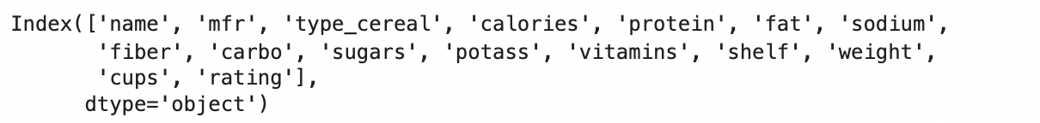
Preprocessing and cleaning data
To preprocess the data we replaced the null values with the median
The index was cleaned up as well
Preprocessing helps assure model efficiency

Slide 6
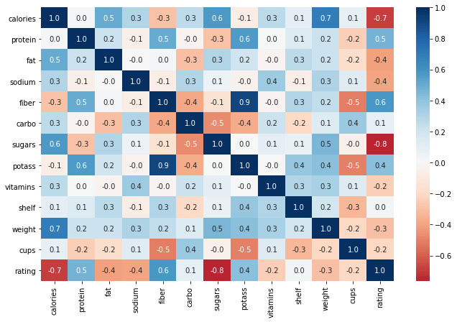
Visualizing data correlation using heatmap
From the graph, we can notice that there are some features that are interdependent on other columns.
This correlation reduces the prediction since we have interdependent columns.
We have to remove the interdependent columns.

Slide 7
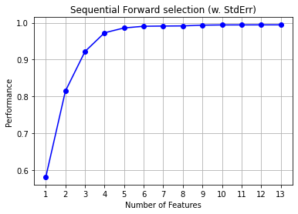
Forward Selection
Forward selection is a technique in which we pass each feature to the model and recognize which features are contributing to the greater prediction
This is one of the wrapper methods in feature engineering, which helps in selecting the best features for any regression or classification model.
We have used two methods for forward selection.
Using dmba package
Using sklearn. Sequential floating selection()

Slide 8
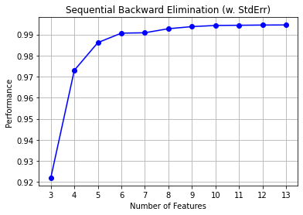
Backward Elimination
Backward Elimination is a technique in which we pass all features to the model initially and step by step remove insignificant features that are having lesser r2 square.
This is one of the wrapper methods in feature engineering, which helps in selecting the best features for any regression or classification model.
We have used two methods for forward selection.
Using dmba package
Using sklearn. Sequential floating selection()

Slide 9
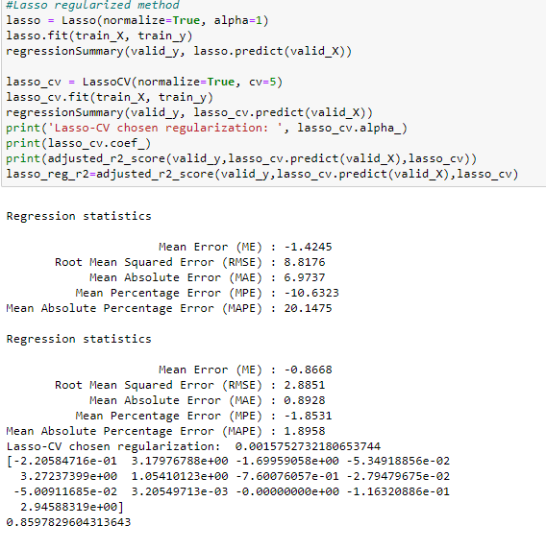
Lasso Penalty Regression
Lasso Regression or least absolute shrinkage and selection operator is a modification of linear regression,
The loss function is modified to minimize the complexity of the model by limiting the sum of absolute values of the model coefficients. (i.e 1)
Loss function= OLS + alpha*summation(absolute values of magnitude of coefficients
Lasso can also be used for feature selection since most insignificant features are reduced to 0.

Slide 10
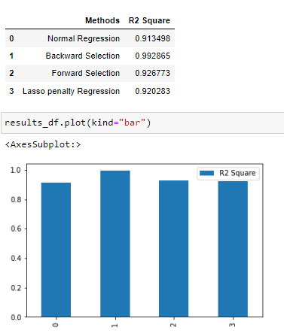
Comparison of models
Based on their R2 Square values
We have created a data frame that consists of the model’s name and their respective r2 square error values.
Ideally, for any regression model higher the r2 square value the better is the model’s predictions.
From this it’s evident that backward elimination had given a better set of features than other methods.

Slide 11
Thank You
Open for discussion

